Slide 1

EXPANDED USE CASES
By – Kanaga Manikandan Solaikannan

Slide 2
What are expanded use cases?
A detailed description of the processes used to complete various system functions (CompTechDoc n.d.).
Talking about how they were used.
Covering on how it provided more knowledge than an existing use case diagram.

Slide 3

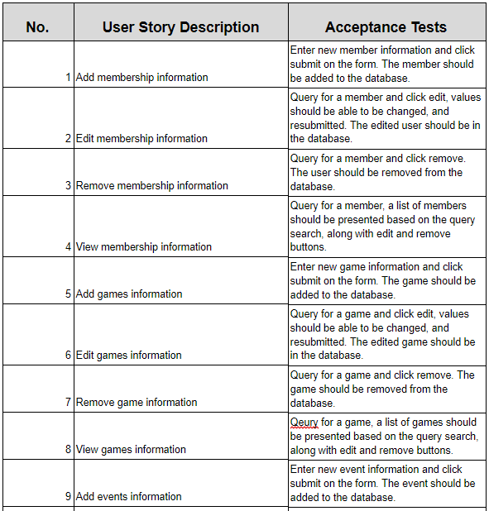
How did it help identify requirements?
Derived from user stories.
Categorise into primary and secondary functions.
Primary functions are essential.
Secondary functions help the user to do more tasks.
Notes:
3rd point – The software will still work even without the secondary functions.

Slide 4
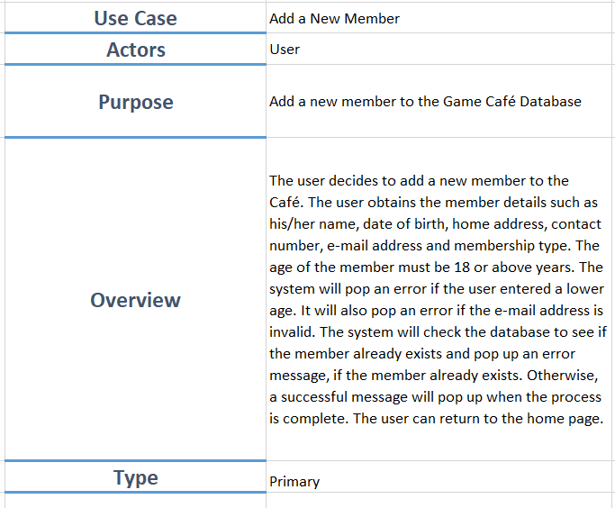
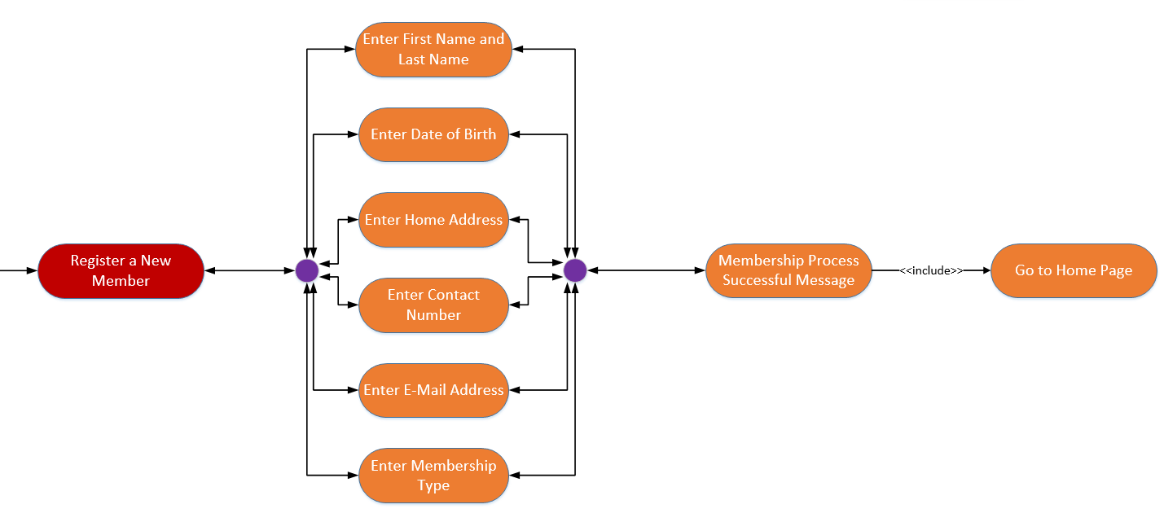
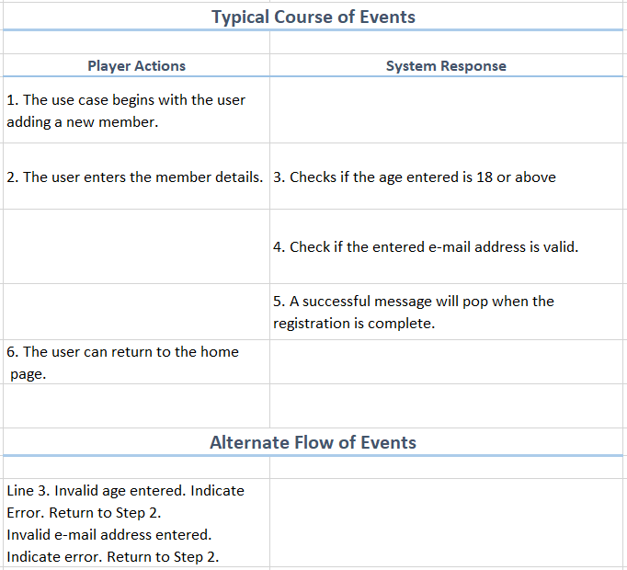
use case diagram to expanded use case
Unable to describe in detail.
Can become cluttered and huge.
Expanded Use Cases helped obtain in-depth information.

Slide 5
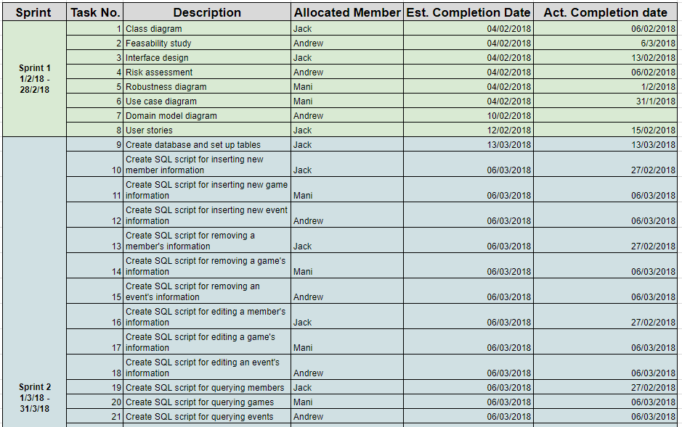
How did it help organise?
Helped the team to sort out the weight of tasks and get them assigned.
Enabled the team to understand the flow of process better.
Notes:
2nd point – The typical course of events [from the expanded use case] enabled

Slide 6
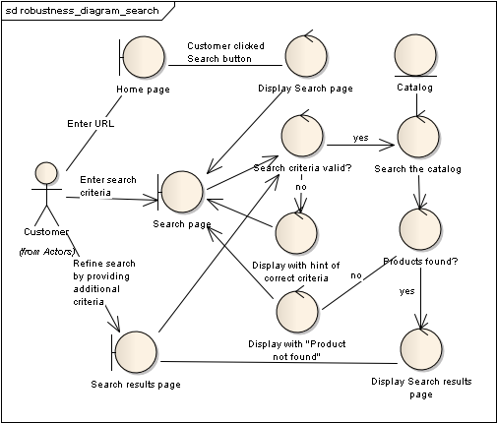
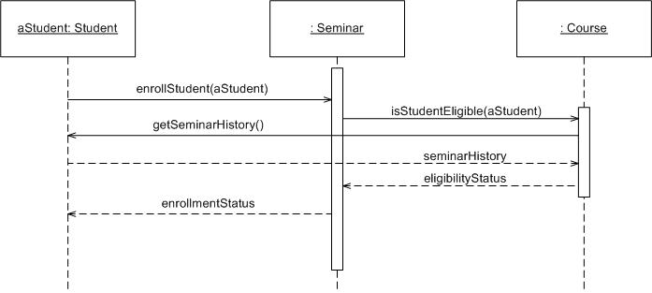
What else can be done?
Other methods are Robustness Diagrams and Sequence Diagrams.
Robustness diagrams - Simplified versions of UML class diagrams (Anon n.d).
Sequence Diagrams - Display object interactions and sequence of messages exchanged (Ambler n.d.).

Slide 7
Why were expanded use cases used?
Still unable to explain each step in more detail.
Expanded Use Cases combines each diagram’s purpose into one single document.
Easy to implement and time-efficient.
Notes:
2nd Point – For example, the typical course of events seen in the expanded use case is what the sequence diagram showcases.
3rd point – I, personally, think it would take less time in writing expanded use cases than drawing a robustness diagram because the diagram had special figures and having them properly placed and aligned was a lot of work. Expanded Use cases where it’s primary textual eased the workload for the team.

Slide 8
References
COMPTECHDOC, n.d. UML Expanded Use Case [viewed 11 April 2018]. Available from: http://www.comptechdoc.org/independent/uml/begin/umlexusecase.html
ANON, n.d. Robustness Analysis [viewed 11 April 2018]. Available from: https://gyires.inf.unideb.hu/GyBITT/07/ch03s05.html
AMBLER S., n.d. UML 2 Sequence Diagrams: An Agile Introduction [viewed 11 April 2018]. Available from: http://www.agilemodeling.com/artifacts/sequenceDiagram.htm

